Slide 1
Unity Through Crisis: How a Coalition of Latinos and Lebanese Americans Helped Save Democracy in the City of Bell
Dr. Michael A. (Mike) Moodian
February 19, 2015

Slide 2
Overview
Brief history of Bell
Bell’s shifting demographics
BASTA meetings at the El Hussein Community Center
The aftermath
Takeaways

Slide 3
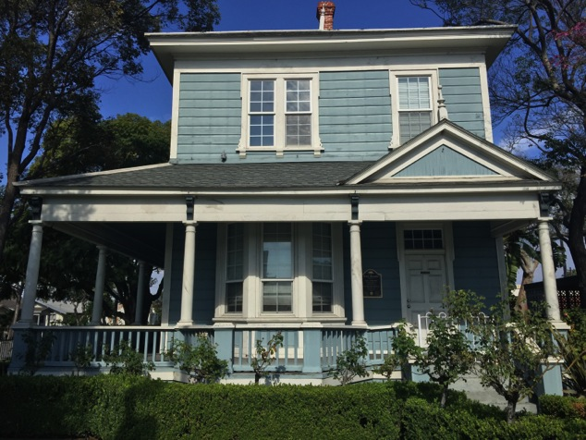
Brief History
Rancho San Antonio
James George Bell buys 360 acres
A community develops
Incorporation 1927
Notes:
Spanish aristocrat Don Antonio Maria Lugo established a 30,000-acre settlement, Rancho San Antonio, on the area that now encompasses Bell, and the King of Spain granted the acreage to Lugo, who would eventually become Los Angeles mayor, sometime between 1810 and 1813.
Between 1870 and 1890, substantial portions were divided into lesser-sized holdings and purchased by new settlers, including James George Bell, the city’s namesake, who bought approximately 360 acres. (Bell’s home is pictured in Figure 1). A farming community developed, and families raised alfalfa, vegetables, chickens, ducks, and some livestock. The area grew from 1900 to 1915, as homes, churches, businesses, and a mutual water company were established. From 1920 to 1935, roughly 15 years after World War I, a population boom occurred, resulting in business, school, and community organization growth.
Bell incorporated as a city in 1927 and developed parks, recreational programs, and a sewer system.

Slide 4
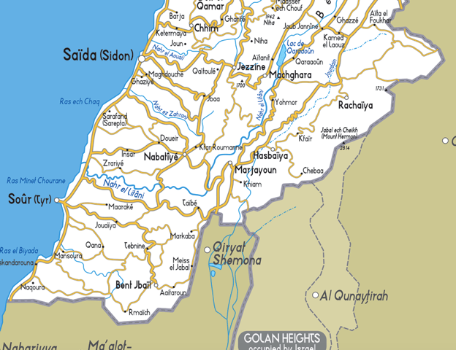
Shifting Demographics
2010 population: 35,477
2009 average household income: $38,473
93.1% Hispanic or Latino
Significant Latino growth in late 1970s and 1980s
Small Lebanese American community established in 1970s
Ali Saleh’s 2009 election
Notes:
According to data on record at the Bell Library (n.d.), the city’s 1990 Anglo population was 3,981, a 53% decease from 1980, and its Hispanic population was 29,583, an 85% increase from 1980.
This surge occurred elsewhere in Los Angeles County in the 1980s, as Los Angeles Times staff writers Michele Fuetsch and Tina Griego (1991) wrote, “Asian and Hispanic populations have surged in Long Beach and the Southeast Los Angeles County area over the last decade, while the Anglo population in almost every community has dropped, according to U.S. Census data released this week” (para. 1). The Times article cited southeast cities other than Bell with the heaviest Latino populations as Maywood, Huntington Park, Commerce, Cudahy, Bell Gardens, Pico Rivera, and South Gate.
According to the U.S. Immigration and Naturalization Service, Mexican immigration to the United States from 1981 to 1990 totaled 1,655,843, up from 640,294 from 1971 to 1980 (U.S. Immigration and Naturalization Service, 1997), an increase reflected in the City of Bell. In exploring push-pull factors, economic opportunity in the United States brought a large surge of Hispanics to the U.S., particularly Los Angeles County, during this time.
In her Wall Street Journal article, Tammy Audi (2010) wrote, “Longtime Bell residents say white residents began to leave Bell in the 1960s for more spacious suburbs in neighboring Orange County” (para. 7). She added, “Race riots in Los Angeles drove more whites away. By 2000, says the U.S. Census, 90% of Bell’s 37,000 population identified as Latino” (para. 7).
In the 1970s, a small Lebanese American community established itself in the city. These immigrants came primarily from Yaroun, Lebanon, a village located on the southern Lebanese border, just north of Israel. The Lebanese Americans in Bell are primarily immigrants or descendants of immigrants who fled civil war in the 1970s.
Los Angeles Times reporter Raja Abdulrahim (2010) described Bell’s Lebanese Americans as living in an enclave of roughly 2,000 on Otis and Brompton streets, near city hall. She wrote, “They have mostly kept to themselves, creating an insular community where only people from their native village in southern Lebanon—Yaroun—are welcome, and outside social and civic involvement is mostly shunned” (para. 8). Bell’s Lebanese American community is composed primarily of Shi’ite Muslims; its Latinos are Roman Catholic and Protestant (Audi, 2010).
When Saleh campaigned for city council in 2009, the year before the scandal erupted, fliers emerged at a local market featuring his head superimposed on a figure holding a sign reading “Islam will dominate the world” (Becerra, 2009, para. 4). The flyer featured photos of people with black hoods standing above a hostage, radical cleric Muqtada al-Sadr, and the burning World Trade Center towers. The bottom of the flier read, “Vote NO Muslims for the City Bell Council 2009” (para. 5). Saleh lost the election, receiving only 375 votes.

Slide 5
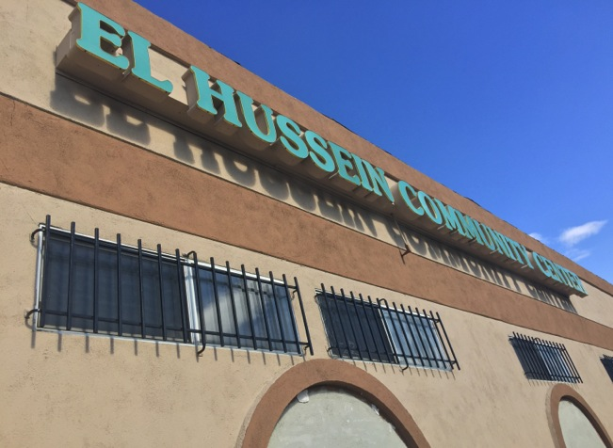
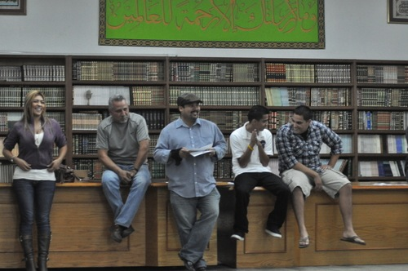
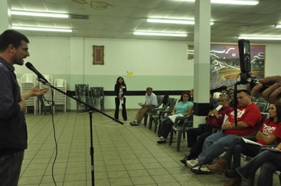
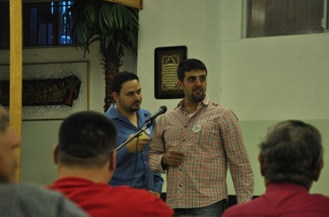
BASTA Meetings at the El Hussein Community Center
Notes:
First we would meet at somebody’s house, and then it became that we couldn’t even fit, and yet alone we still had a lot of people that wanted to come. So we started talking, and we were like okay, we don’t have money to rent a place, there’s not a lot of big places that we can choose in the city, and somehow we said the El Hussein Center [Figure 4], but we were skeptical about having the El Hussein Center because first you’ve got Muslims, and you’ve got the whole media. We didn’t know how that would be received. To my surprise, when we did do that, the community was very open about it. They were very receptive. I remember when we first opened it, people started looking around, [asking] what is this? They were kind of looking at the walls and all they saw were four walls with nothing on there. One side of the wall just had all these religious books; it’s like a little mini library, and some photos. What we would do is we would have all these stackable chairs, and we would have to take them one by one to have people sit down, and after a while, either me or somebody else would open the door to the El Hussein Center, and they would walk in by themselves and start organizing the chairs like it was their own house, which was neat because you kind of saw that okay, we’re working together, they felt comfortable being in here, and it’s kind of great that they feel they’re a part of us, that we’re all one. That’s where it kind of all revolved. The media started coming. We had at one point 600 to 700 people at the El Hussein Center and it was packed to the last chair. (A Saleh, personal communication, February 3, 2015)
However, in Bell, it was a Muslim community center that served as the gathering place for a great American activist movement.

Slide 6
The Aftermath
How have Latino-Lebanese American relations changed since the BASTA movement, recall, and election of new councilmembers?
Notes:
How have Latino-Lebanese American relations changed since the BASTA movement, recall, and election of new councilmembers? “The election kind of opened doors,” Saleh said (A. Saleh, personal communication, February 3, 2015). Alvarez added, “Before [the BASTA movement] it was like everybody was in their own world. That really brought us together at that time” (V. Alvarez, personal communication, February 3, 2015). “I’ve been knocking on doors [for reelection] and people know who I am, know my name, are very receptive, and want to support me,” said Saleh (A. Saleh, personal communication, February 3, 2015).
My mom one time was at the market. My mom wears the hijab, which is the scarf cover, and my mom is also fluent in Spanish, as I am. And she was in the line, and a lady and husband were right behind her, and she started talking in Spanish to her husband and said, “Oh, this lady is the same as our mayor.” My mom turned around and said, “Oh, that’s my son.” They started talking and having a good conversation. Even in the schools, my kids go to school here locally and they’re very receptive. I didn’t have that when I was young. Now they’ve become one where they play together; they go out together. It’s a city where everybody’s receptive to everybody. (A. Saleh, personal communication, February 3, 2015)
Addressing some people’s discomfort with meeting in the El Hussein Community Center, Garcia (2015) wrote, “Everyone learned to be respectful of the center, ask questions of each other, and, by working side by side, some of the hesitation about each other’s cultures started to melt away” (p. 14). The coalition had its challenges, including the need for Saleh to gain approval from the center’s elders to allow BASTA to continue to use the facility, which received threats. “I won’t pretend it was perfect or we broke down giant barriers, but we definitely moved stuff in the right direction” (p. 14).
Others have a different viewpoint. “There isn’t a good fit between the Latino and Arabic/Lebanese community. It’s fabricated, it’s artificial,” said Valencia (N. E. Valencia, personal communication, February 5, 2015). Valencia elaborated on what he believes is a lack of engagement among Lebanese American students in pubic schools. “Like any immigrants, past, present, or future, the acclimation is not a smooth one” (N. E. Valencia, personal communication, February 5, 2015). Additionally, “The Lebanese and Muslim communities are still stigmatized because of 9/11 and all that, and it’s unfair to them” (N. E. Valencia, personal communication, February 5, 2015). He added, “When they did get together, it was for mutual gain, mutual tit for tat, and it was artificial. Above all, artificial. It was fabricated for the purpose of the police department” (N. E. Valencia, personal communication, February 5, 2015). In an e-mail conversation, Bell Councilmember Ana Maria Quintana, who declined a telephone interview for this paper, wrote, “A Lebanese leader surfaced from the scandal but I would most definitely not frame it [as a Latino-Lebanese American coalition that saved democracy]” (A. M. Quintana, personal communication, February 2, 2015). She wrote, “The common factor was simple outrage at the abuse. Everyone, humans from all over the world and walks of life, had a similar reaction” (A. M. Quintana, personal communication, February 2, 2015).

Slide 7
Three Takeaways
Communicating successfully across diversity
Representatives of American ideals
Cultural plurality to amalgamation

